Slide 1
Scrum-Agile approach
Key facets and comparison by Carlos Oviedo

Slide 2

Product owner Role
Responsible for the value of the product and work of development team
Manage product backlog to achieve goal and missions
Ensures the development teams understands items in the product backlog
Ensures the product backlog is transparent and clear to all members of the team

Slide 3




Scrum master role
Responsible for ensuring scrum is understood and enacted
Understands product planning in an empirical environment
Ensures product owner knows how to arrange the product backlog
Coach the development team in self organization and cross-functionality
Facilitates scrum events as requested or needed

Slide 4
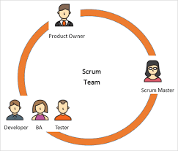
Team member role
Development team who do the work of delivering a potentially releasable increment of “Done” product at the end of each sprint
Turn backlog into increments of potentially releasable functionality
Cross functional, all tools necessary to create a product increment
Accountability belongs to the development team as whole
Tester, business analysis all are part of team role
no sub-teams in development team

Slide 5
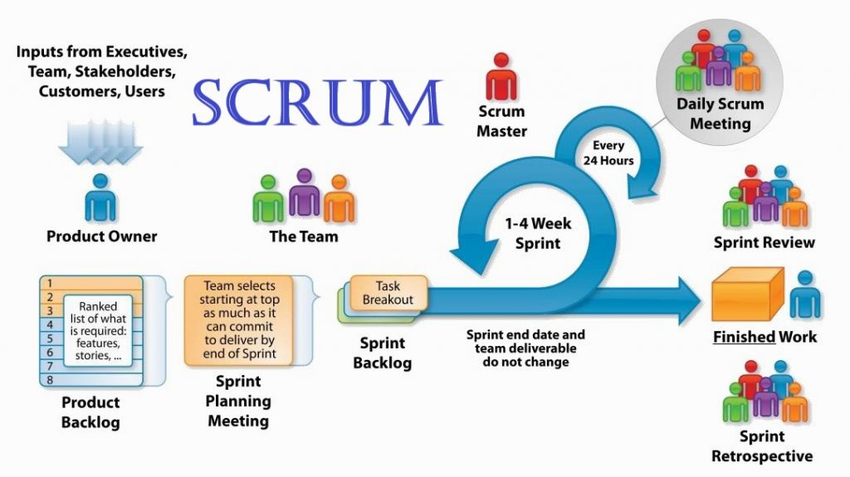

SDLC
Agile phases

Slide 6
Scrum-agile vs waterfall
Scrum-agile approach
Waterfall approach
Very realistic approach to software development
Promotes teamwork and cross training
Suitable for fixed or changing requirements
Deliver early partial working solutions
Flexible, no rigid planning needed
Simple and easy to understand
Easy to managed due to rigid of model
Phases and process are completed one at a time
Defined stages

Slide 7
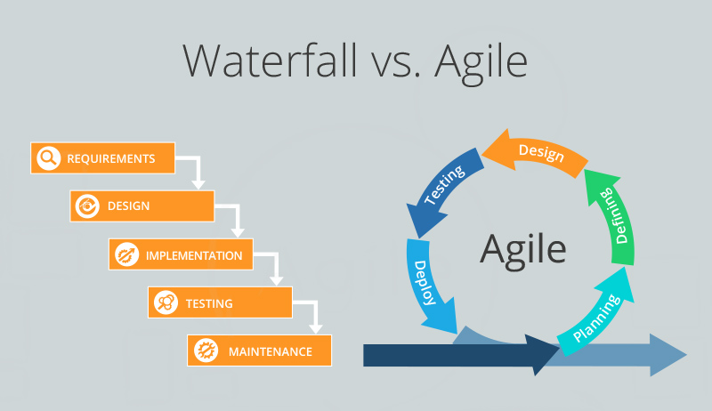
Choosing an approach
Waterfall or Agile?
Waterfall – simple projects, small changes or no changes, no need for testing.
Agile – complex projects, need of changes, user feedback, testing of development

Slide 8
References
SDLC Tutorial. (n.d.). Retrieved from https://www.tutorialspoint.com/sdlc/index.htm
Charles G. Cobb. (2015). The Project Manager’s Guide to Mastering Agile : Principles and Practices for an Adaptive Approach. Wiley
What is Scrum? (n.d.). Retrieved from https://www.scrum.org/resources/what-is-scrum
Google images. Scrum vs waterfall https://www.google.com

